Slide 1
Menstrual Pain Garment
Team P: Hannah Bagshaw, Michael Corbi, Erin Hanlon and Andrew Mister

Slide 2
Table of Contents
Introduction
Design
Prototype and Testing
Cost Reconciliation
Conclusion

Slide 3
Introduction

Slide 4
Meet the Team
Hannah Bagshaw
Michael Corbi
Erin Hanlon
Andrew Mister
(Stakeholder)

Slide 5
Project Background
Engineering Entrepreneurship Summer Institute 2019
Valiant
Value Proposition:
“Valiant helps women who want to get their livelihood back by alleviating menstruation pain and promoting comfortability.”

Slide 6
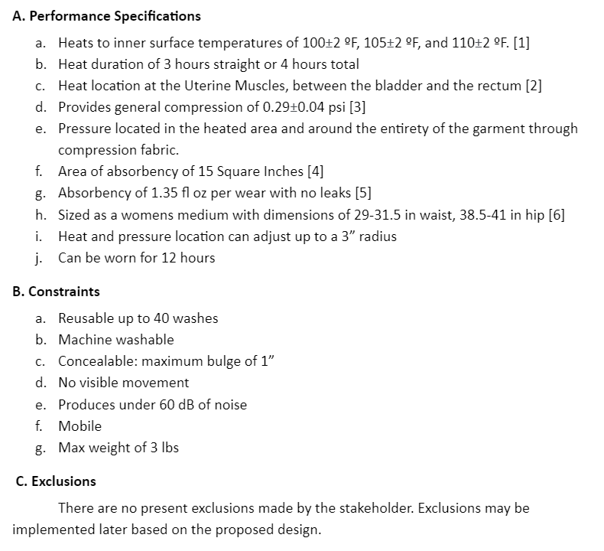
Project Scope
Major Ideas:
Heating
Compression
Absorption
Concealability
Engineering Principles:
PID + Heat

Slide 7
Design

Slide 8
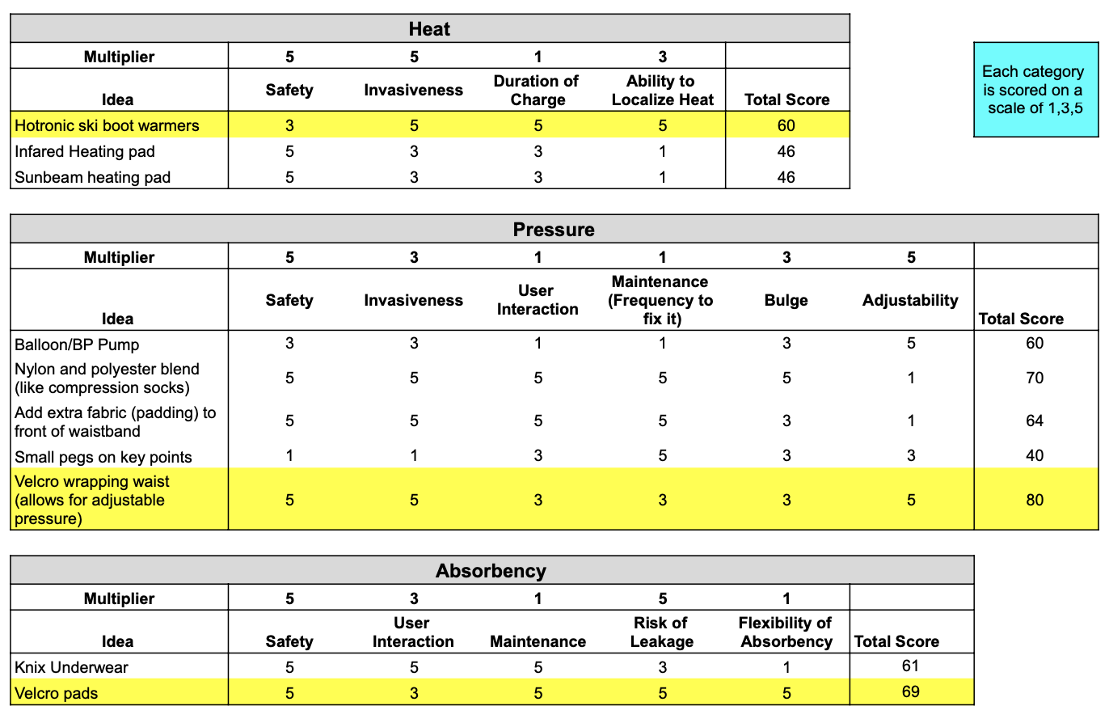
Preliminary Design Ideas
Ideas curated by team members, advisors, and HazOp reviewers
Decision Matrix
Each idea is weight in a number of relevant categories
Each category has a weight of importance to the scope
Highlighted ideas are chosen to be carried on to the final design

Slide 9
Engineering Principles and Concerns
Temperature of heating component to relieve cramping
Henrique’s burn integral
Pennes’ bio-heat equation
PID Loop Heat safeguard
Temperature sensor installed to control the level of heat that reaches the skin
Compression safety
Value of 0.29±0.04 psi is the ideal pressure value to ensure safety of the user
Safety and sanitation of removable pads
Product FDA approved via 501(k) approval process

Slide 10
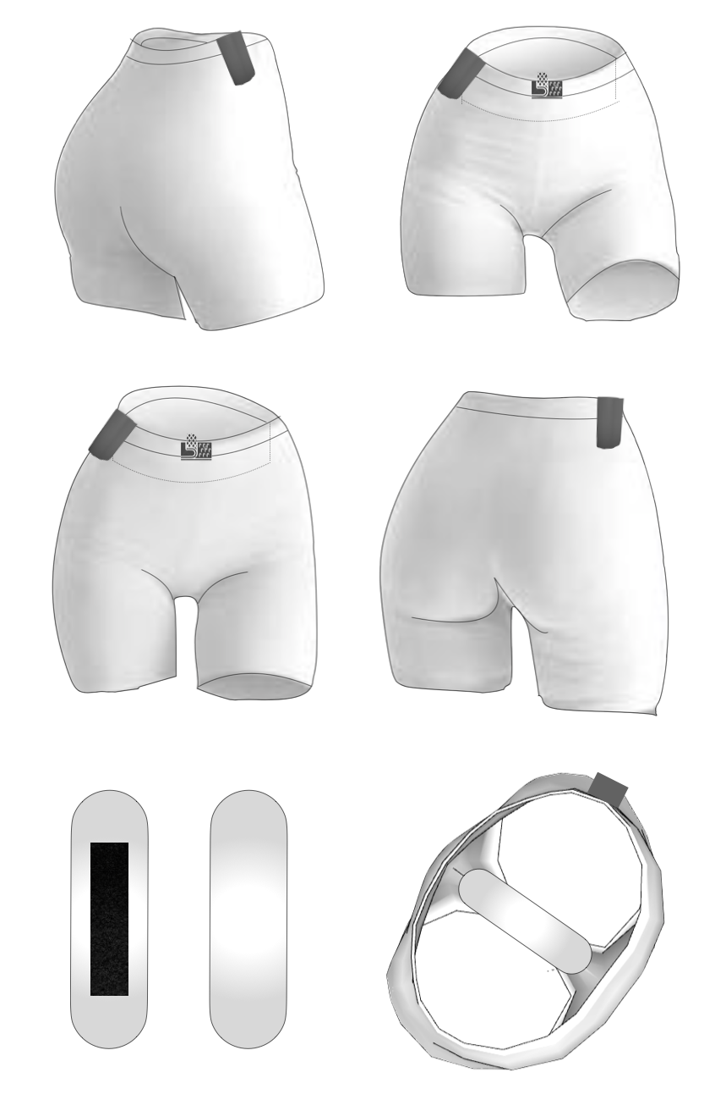
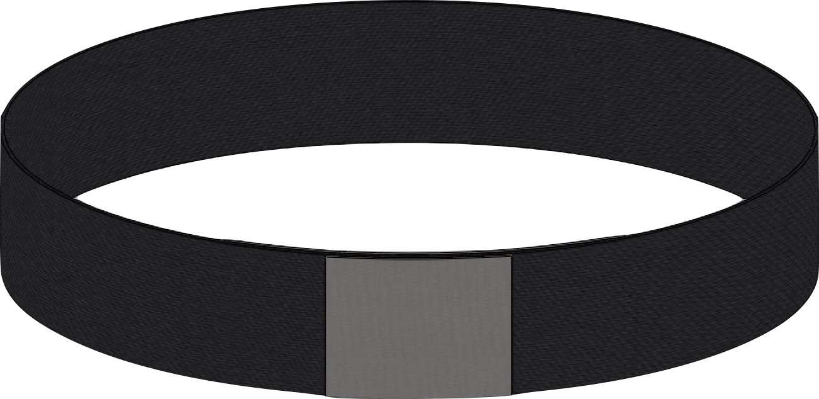
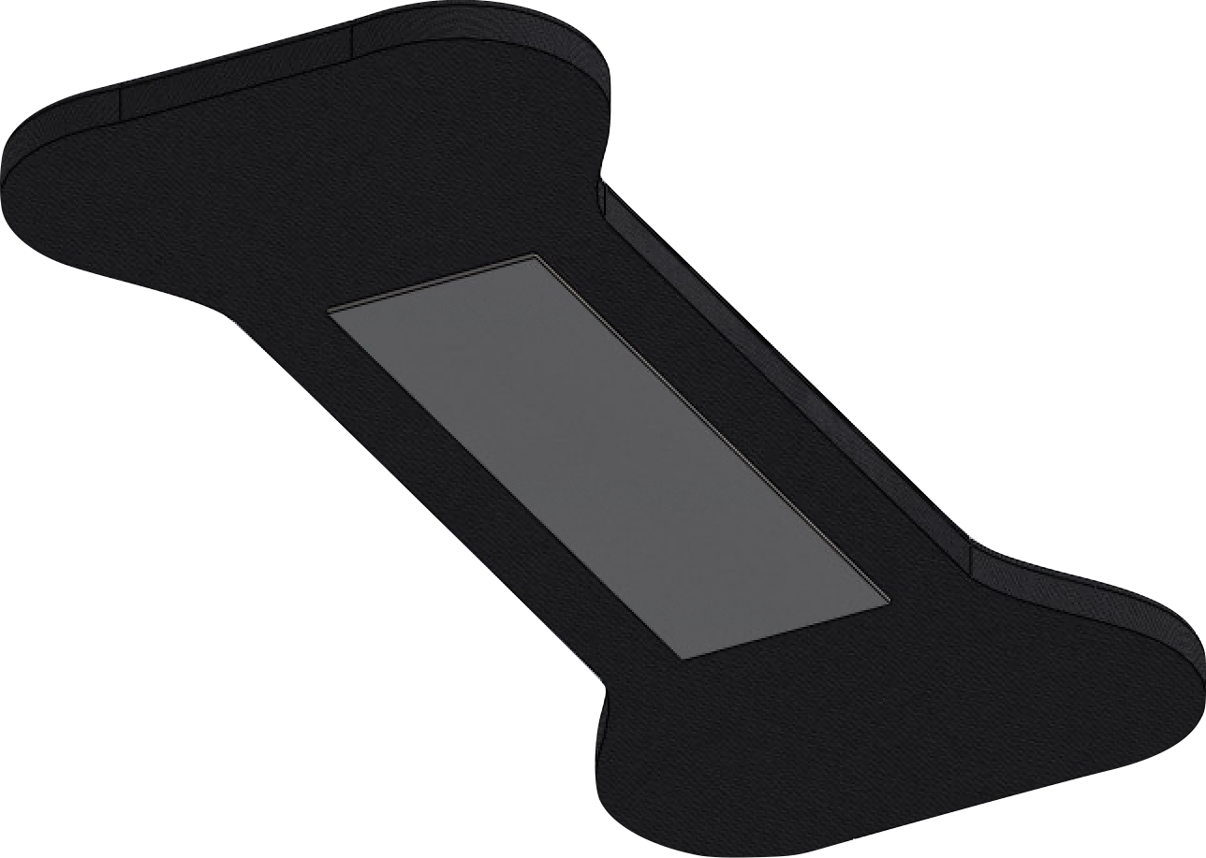
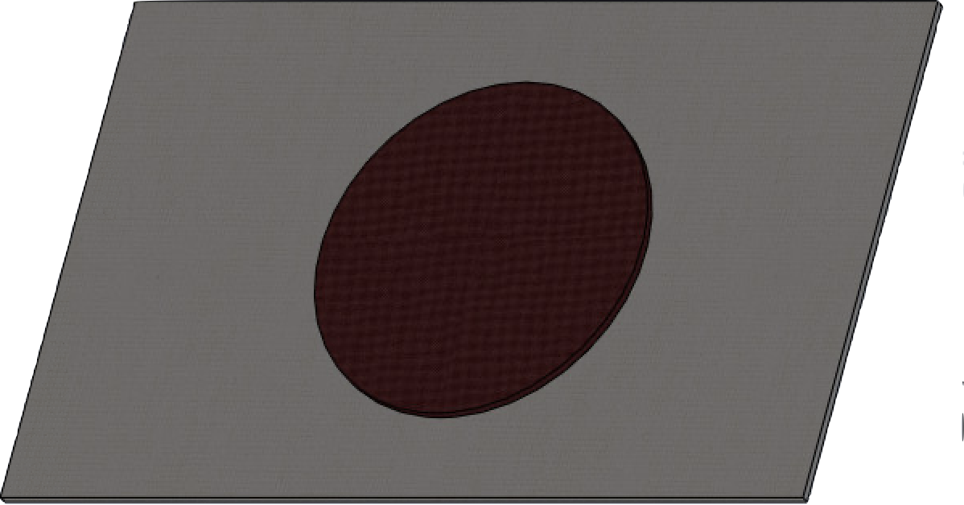
Final Design
Pressure
Shorts made of compressive fabric
Compressive waistband with velcro
Heat
Removable heating pad with 3 settings
Absorbency
Removable velcro pad
Overall Design Components
Inside pocket for heating location adjustability
Side pocket for battery storage
Top to bottom: Velcro Waistband, Absorbent Pad, Heating Pad
Final Design rendering

Slide 11
Prototyping and Testing

Slide 12
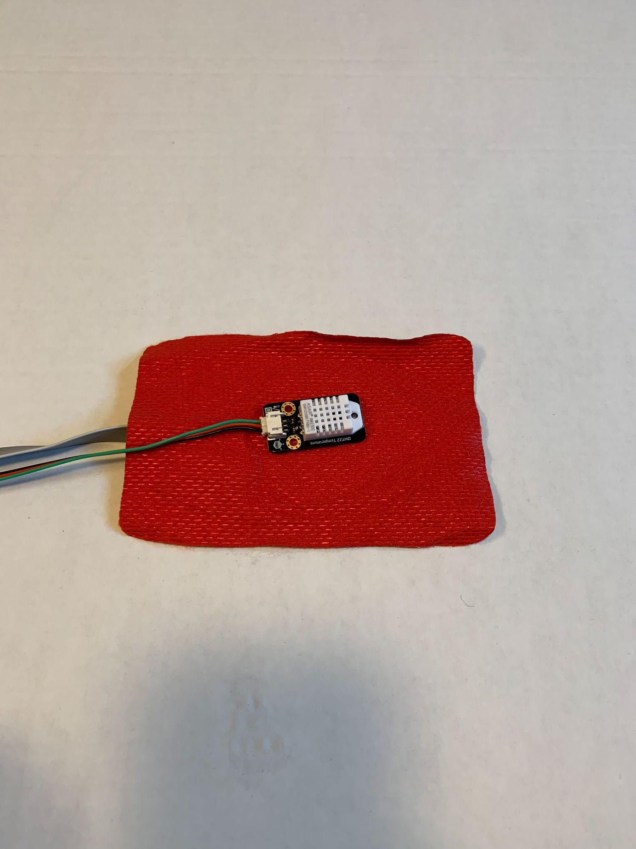
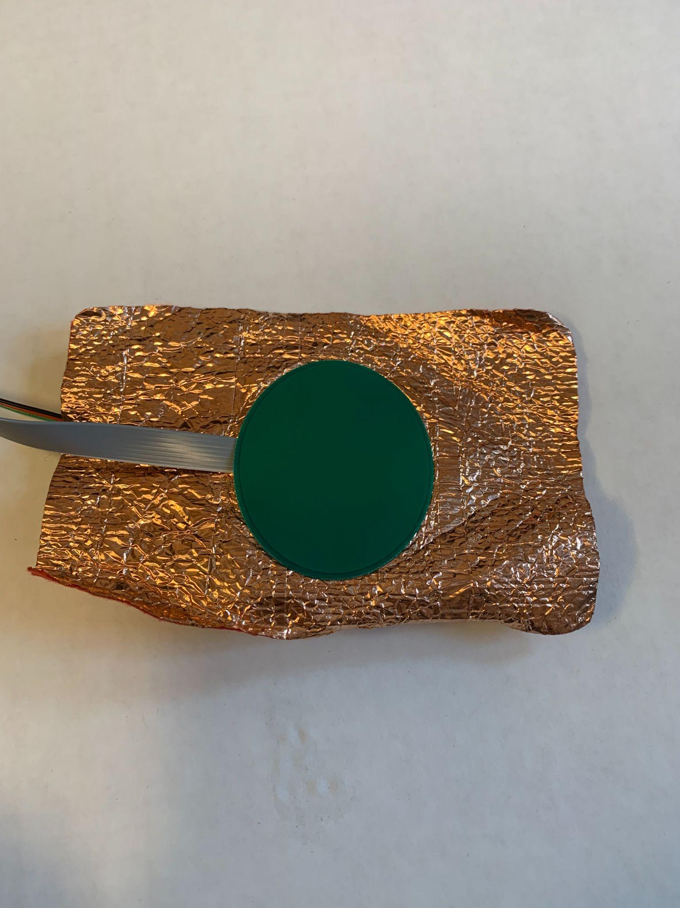
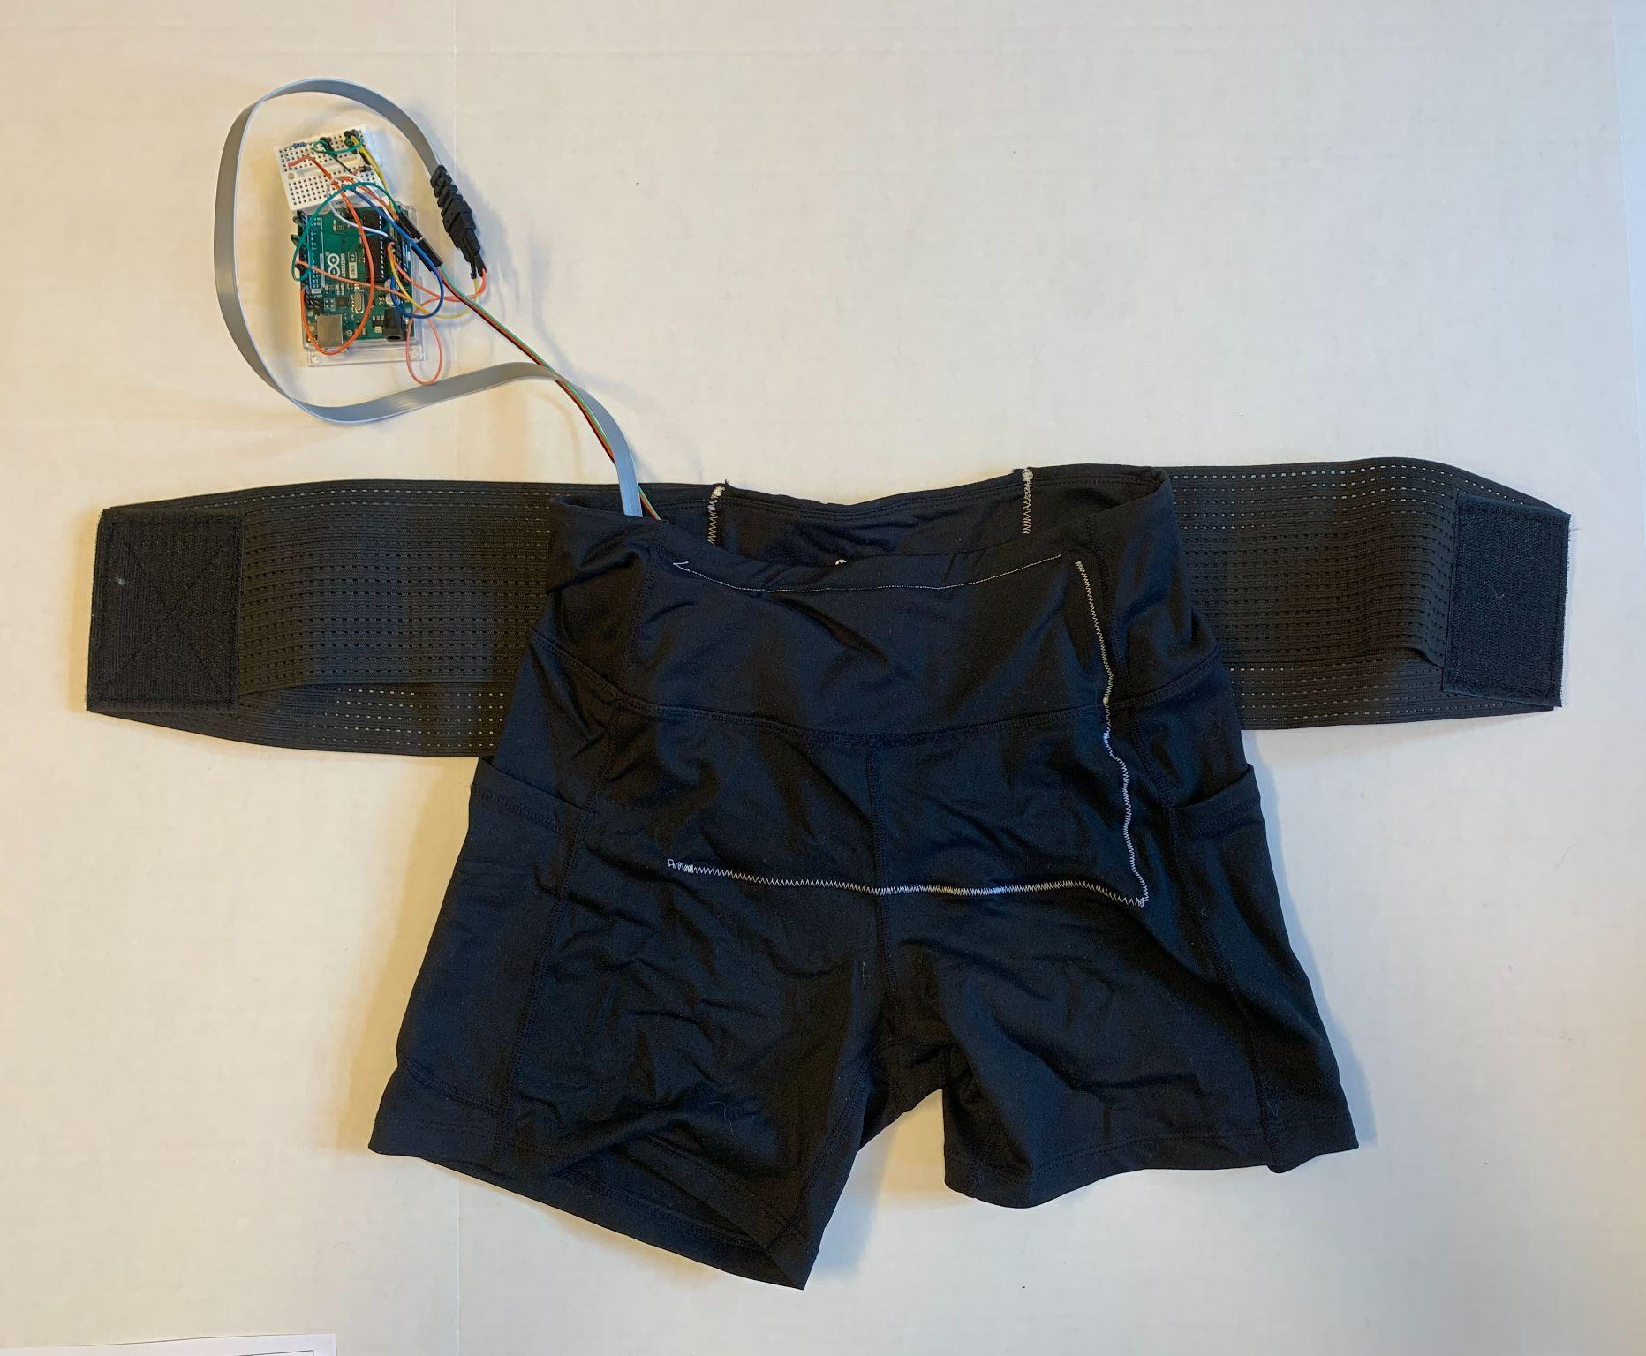
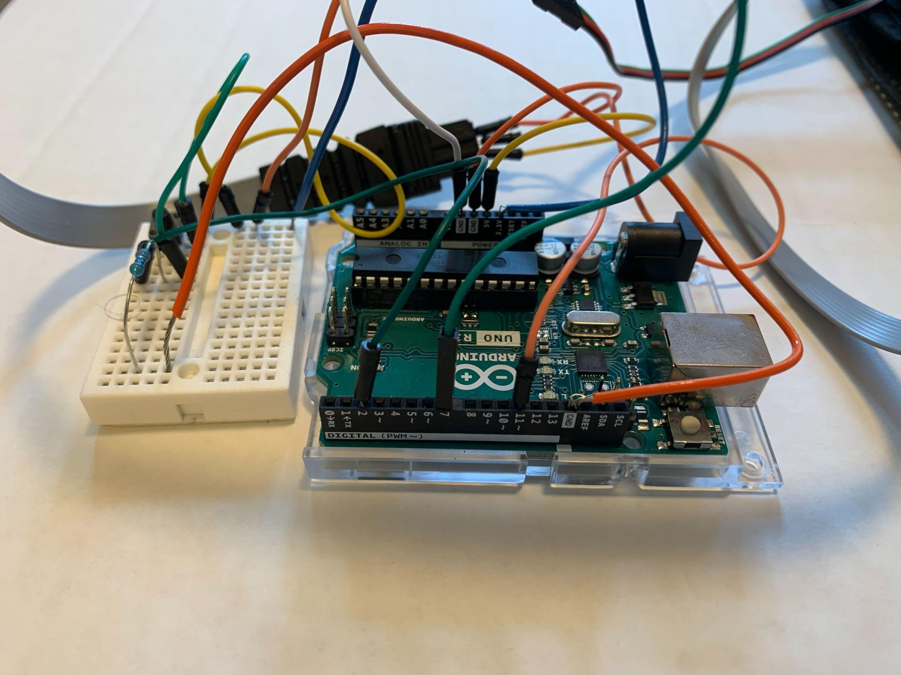
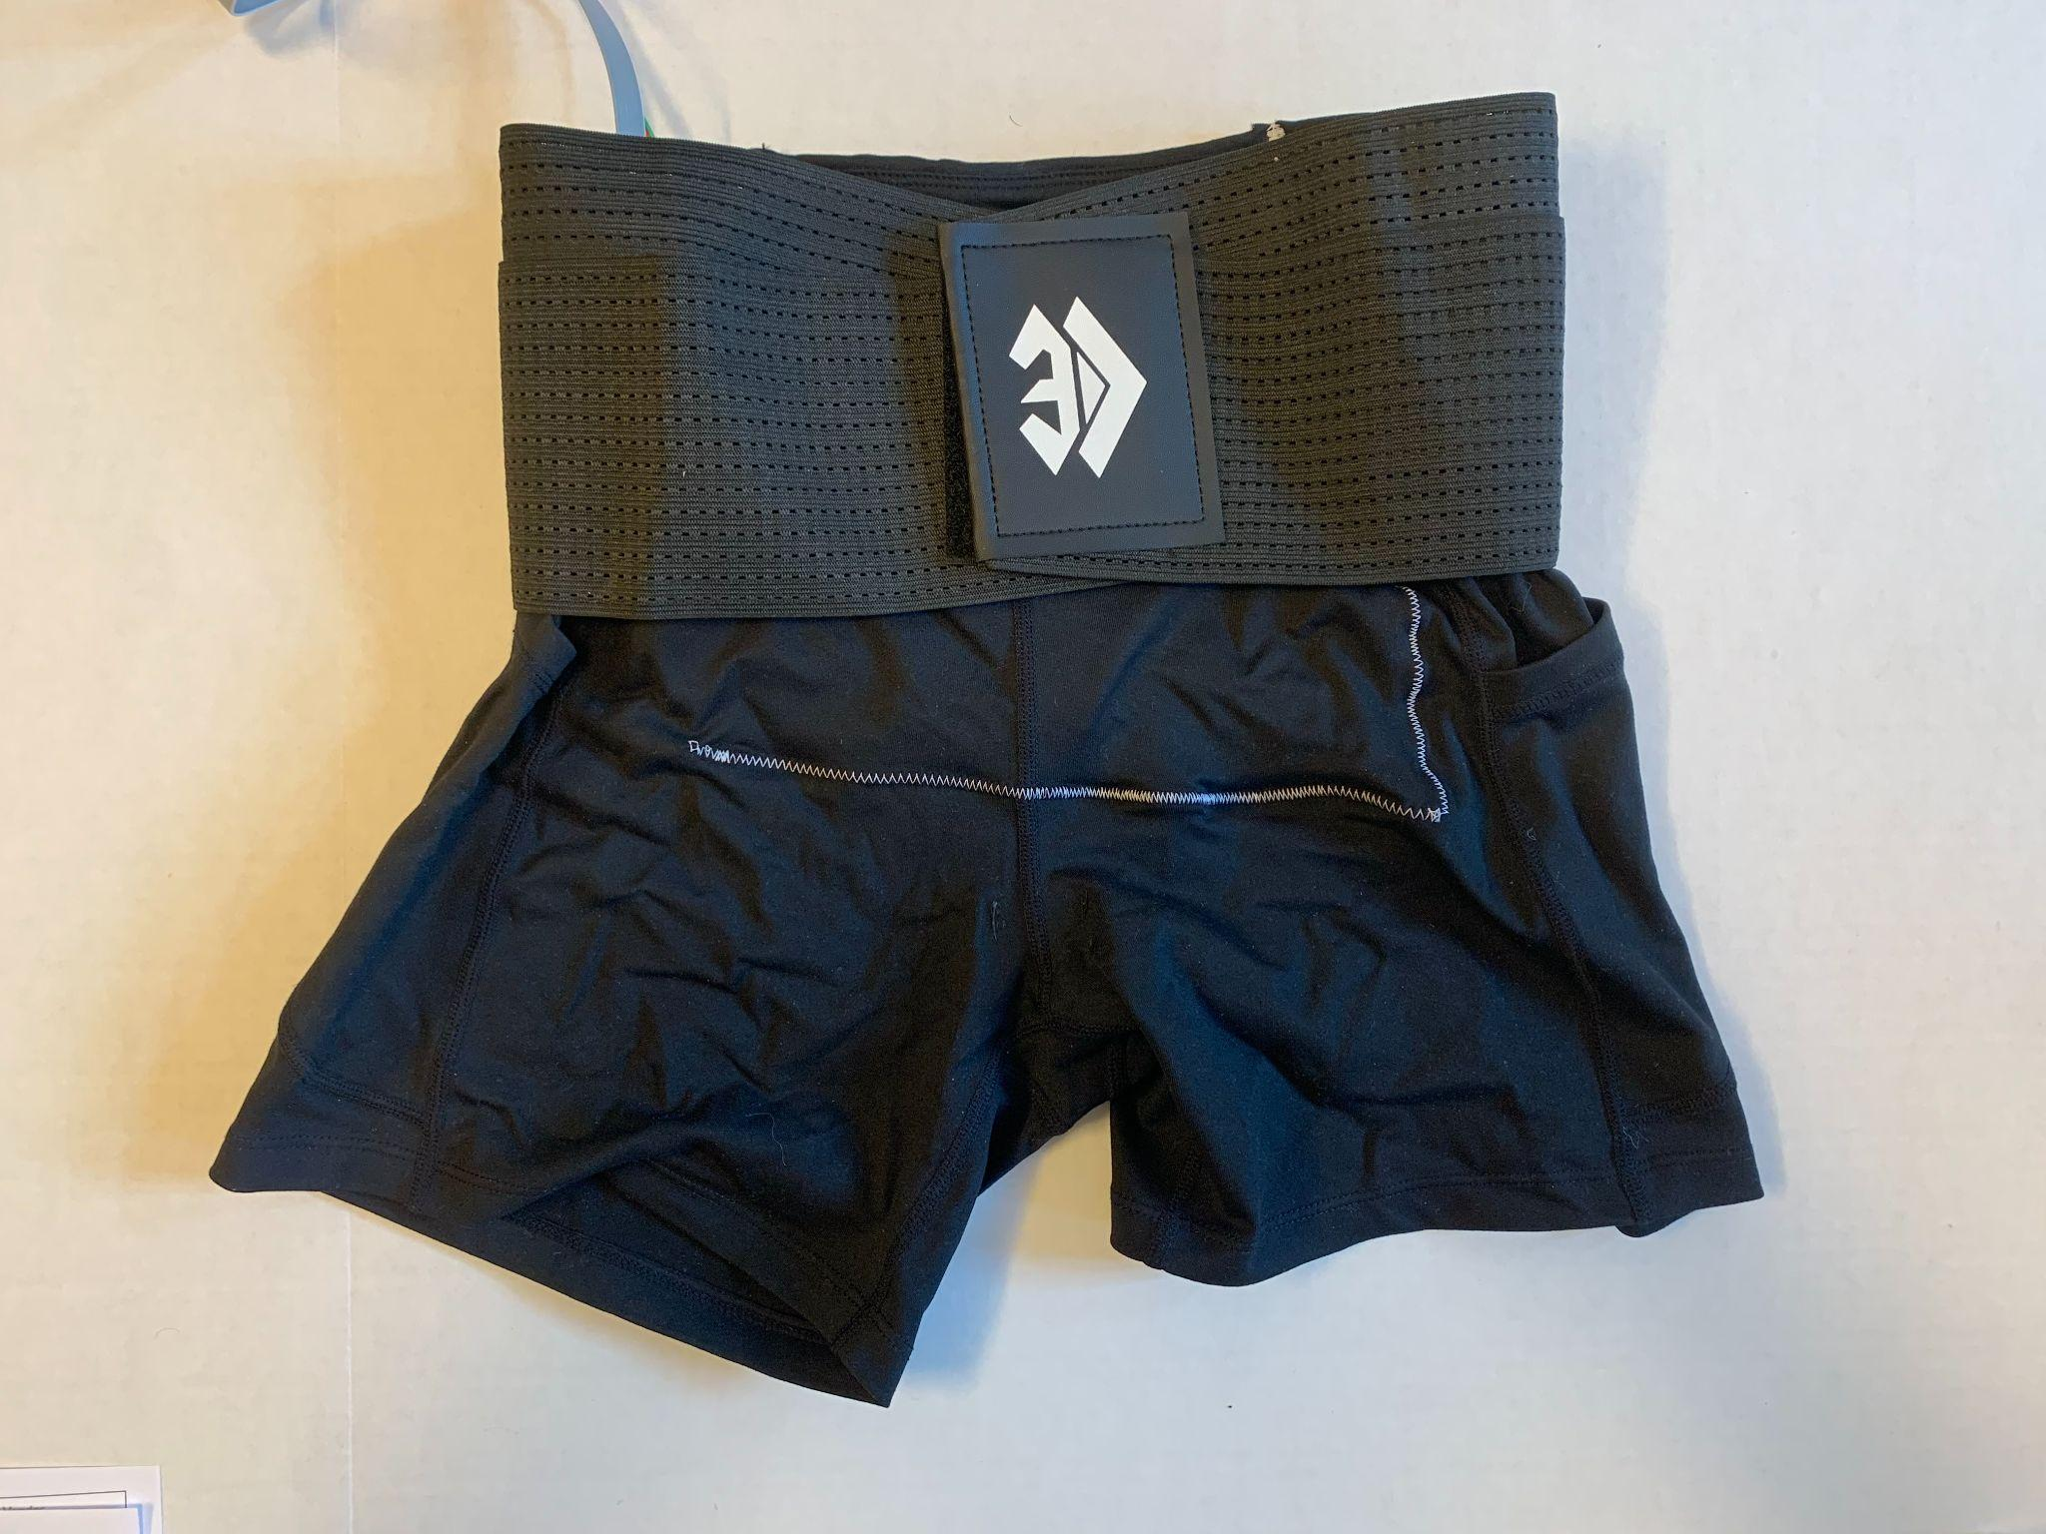
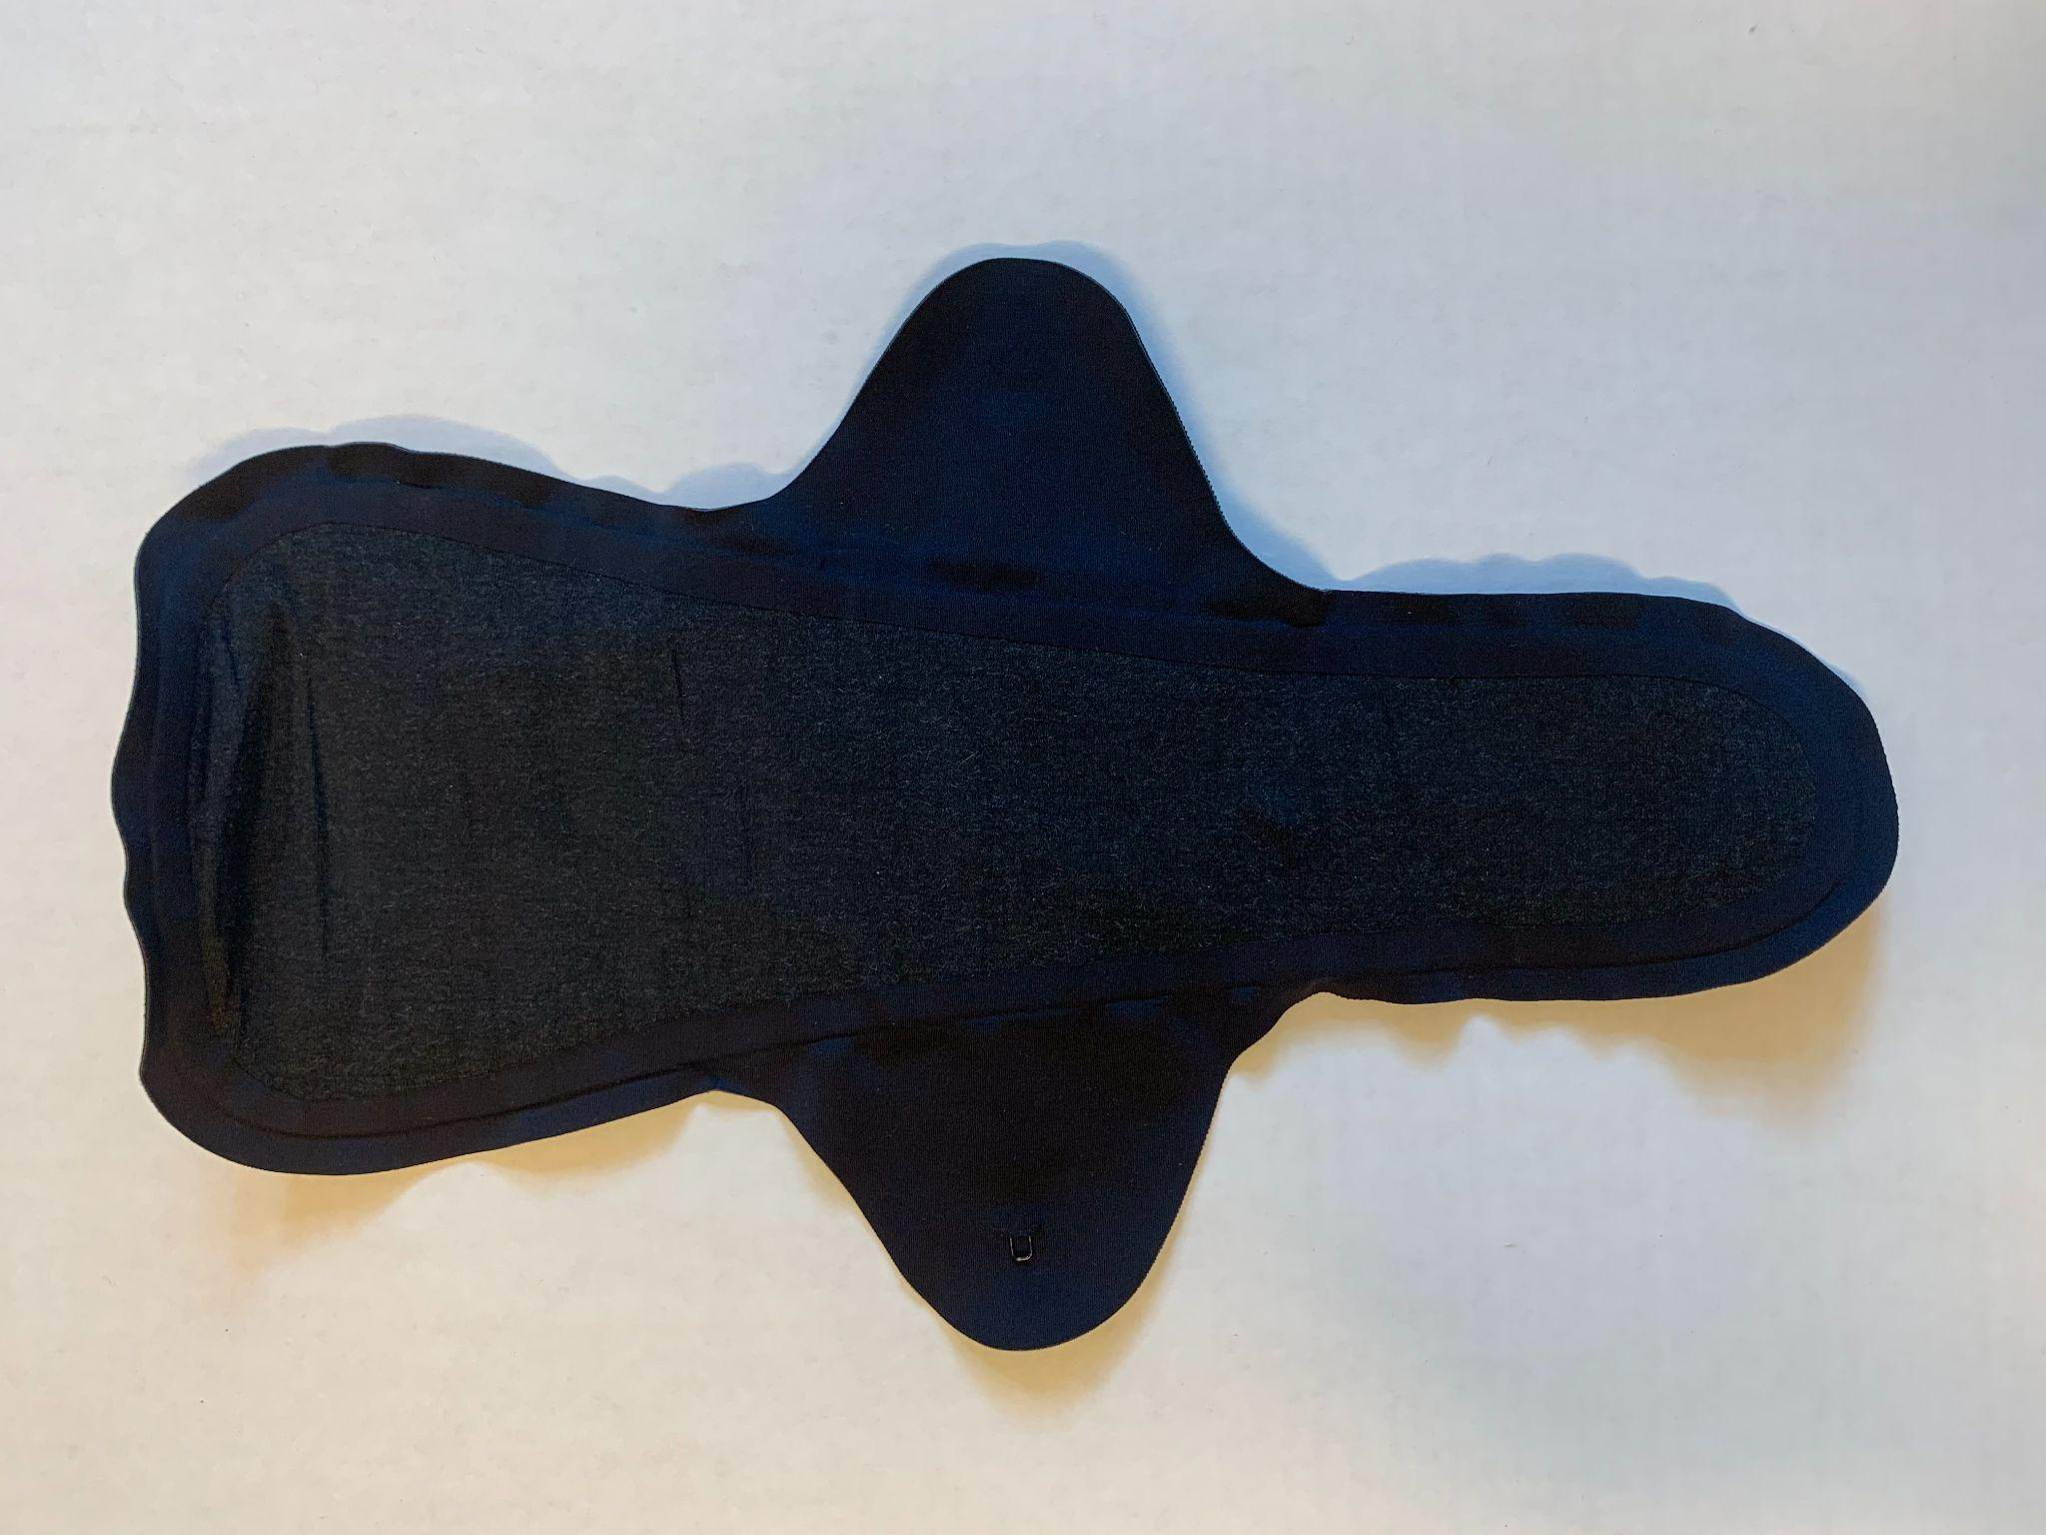
Assembly

Slide 13
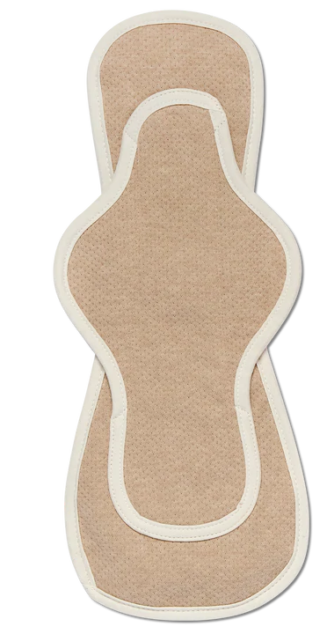
Troubleshooting
OLD
NEW
Conduction over large enough area
Pad not absorbing

Slide 14
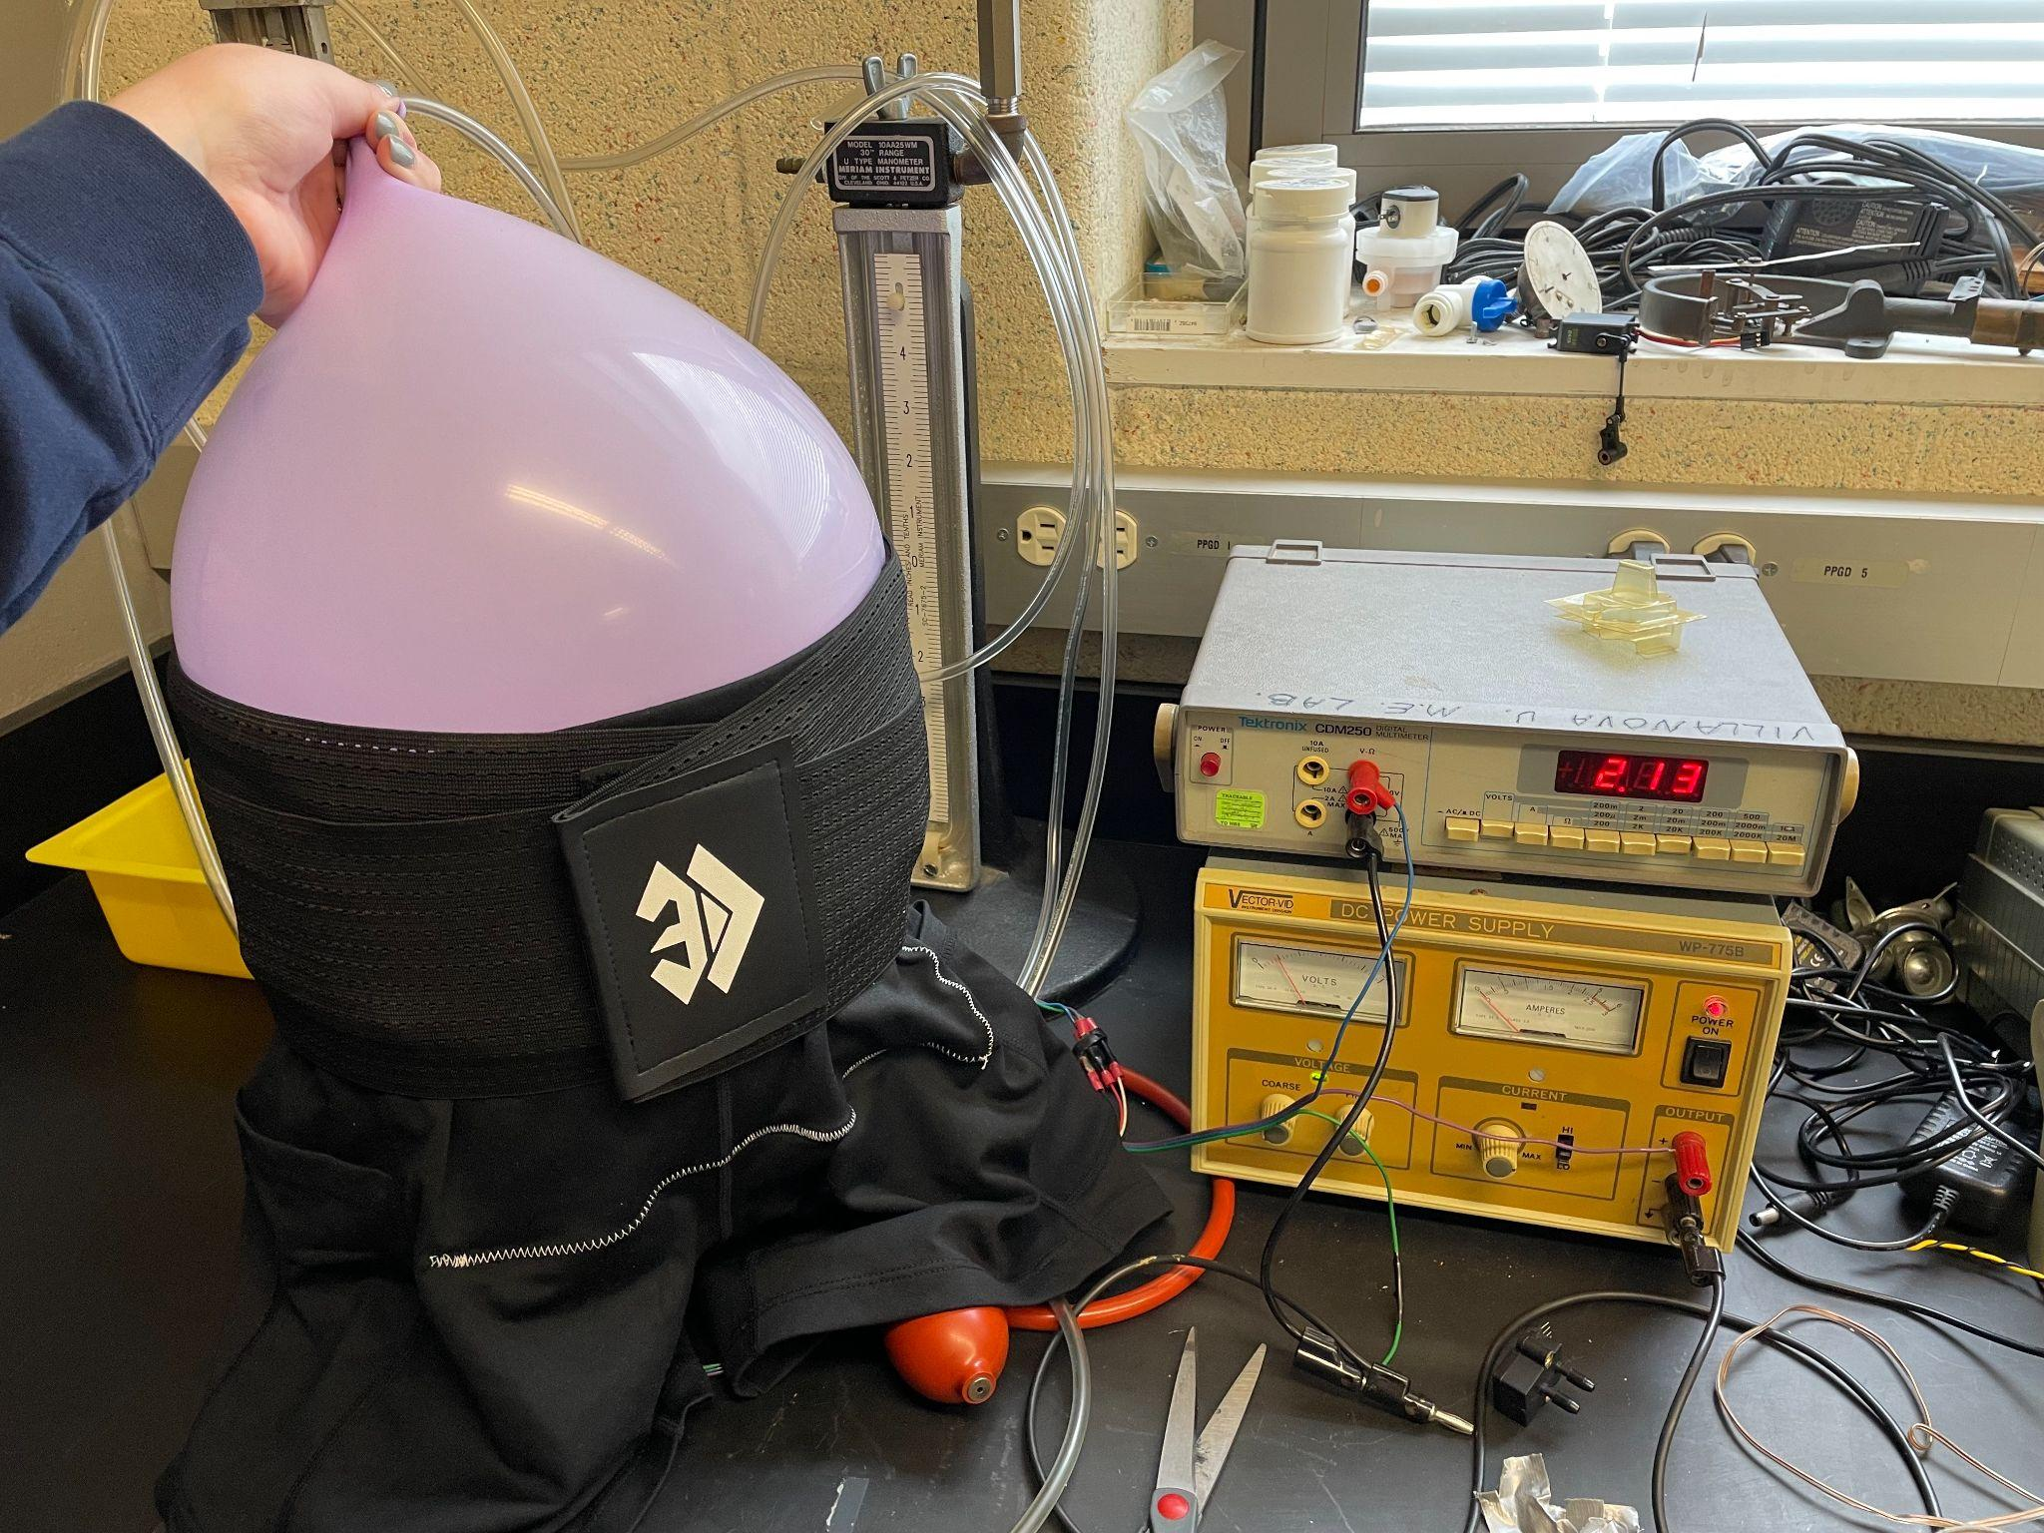
Commissioning and Testing
Quality Control - Functionality of parts
Completion - Proper placement & tightness of parts
Pre-Commissioning - Battery is charged and alignment of waistband
Commissioning - Turn on battery & size/location of components
Testing - Scope requirements

Slide 15
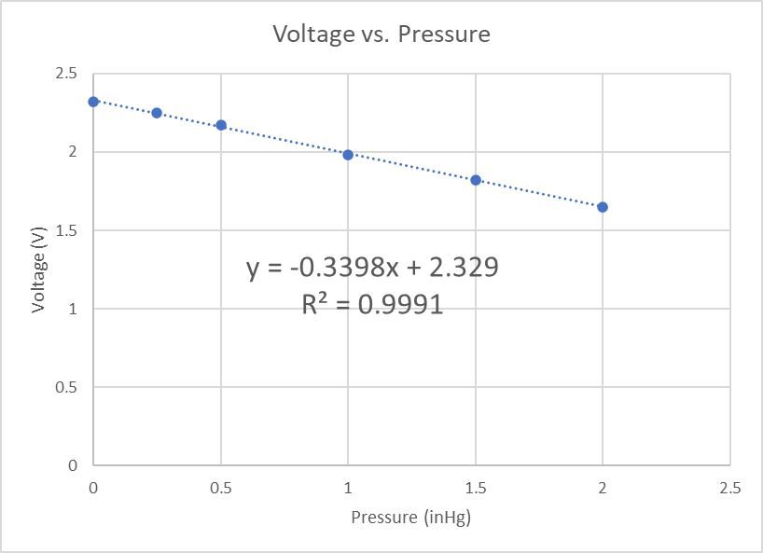
Final Test Results
Applies Pressure
Average voltage 2.12 V
2.12 V → 0.615 inHg = 0.302 psi
Applies Heating
All 3 settings, shut off successful
Absorbency
1.35 fl oz, no leaks
Adjustable Temperature and Pressure
Button, Velcro
Reusable
Electrical Removed

Slide 16
Cost Reconciliation

Slide 17
Budget vs. Actual Cost
Comparison
Item | Budget | Actual
Pad | $33 | $45
Ski Boot Warmer | $219 | $219
Compression Shorts | $18 | $20
Compression Straps | $21 | $22
Temperature Sensor | $11 | $14
Arduino | $23 | $23
Steady State Relay | $55 | $0
Wires | $6 | $0
Buttons | $18 | $0
Velcro Strips | $9 | $11
Compression Fabric | $10 | $11
Temperature Fuse | $0 | $8
Balloons | $0 | $15
Replacement Pads | $0 | $54
Subtotal | $423 | $443
Contingency | $37 | $0
TOTAL | $460 | $443
Steady State Relay, Wires, & Buttons
Pads, Balloons, & Temperature Fuse
Under Budget

Slide 18
Conclusion

Slide 19
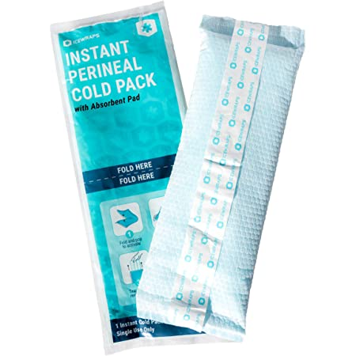
Determinations and Recommendations
Majority of scope and objectives met
Bulge
Improvements
Soldering of wiring
Improved temperature control
Full implementation of all safety features
Alternate use: post-birth

Slide 20
Thank You
Advisor: Prof. Michael Simard
HazOp Reviewers: Dr. Ani Ural, Dr. Jens Karlsson
Consultants: Dr. Garrett Clayton, Prof. George Simmons

Slide 21
References
Amazon ICEWRAPS Instant Perineal Cold Pack. Accessed April 20, 2022. https://www.amazon.com/ICEWRAPS-Instant-Perineal-Reusable-Bundle/dp/B09NBFJ5XQ
“Researchers Test Heating Pads as Home Remedy for Menstrual Pain.” WebMD, WebMD, 26 Mar. 2001, www.webmd.com/women/news/20010326/researchers-test-heating-pads-as-home-remedy-for-menstrual-pain.
“Uterus.” Encyclopædia Britannica. Encyclopædia Britannica, inc. Accessed September 13, 2021. https://www.britannica.com/science/uterus.
Lijing, Wang, Martin Felder, and Jackie Y Cai. “Study of Properties of Medical Compression Fabrics.” Journal of Fiber Bioengineering & Informatics 4, no. 1 (2011): 15–22. https://doi.org/10.3993.
YIFASHIONBABY Reusable Sanitary Pads. Accessed September 13, 2021. http://www.yifashionbaby.com/sanitary-pads/yifashionbaby-bamboo-charcoal-reusable-cloth-sanitary-pads-napkins-for-women-daytime-overnight-5-pack-3-sizesml-yw19.html.
Holland, Kimberly. “How Much Blood Do You Lose on Your Period?” Healthline. Healthline Media, May 30, 2018. https://www.healthline.com/health/how-much-blood-do-you-lose-on-your-period#causes-of-heavy-bleeding
“Women's Bottoms Size Chart.” Nike.com. Accessed September 13, 2021.
Song, Guowen, R. Barker, D. R. Grimes, and D. Thompson. “Comparison of Methods Used to Predict the Burn Injuries in Tests of Thermal Protective Fabrics.” Journal of ASTM International, 2, No. 2 (February 2005) https://doi.org/10.1520/JAI12117.

